Slide 1
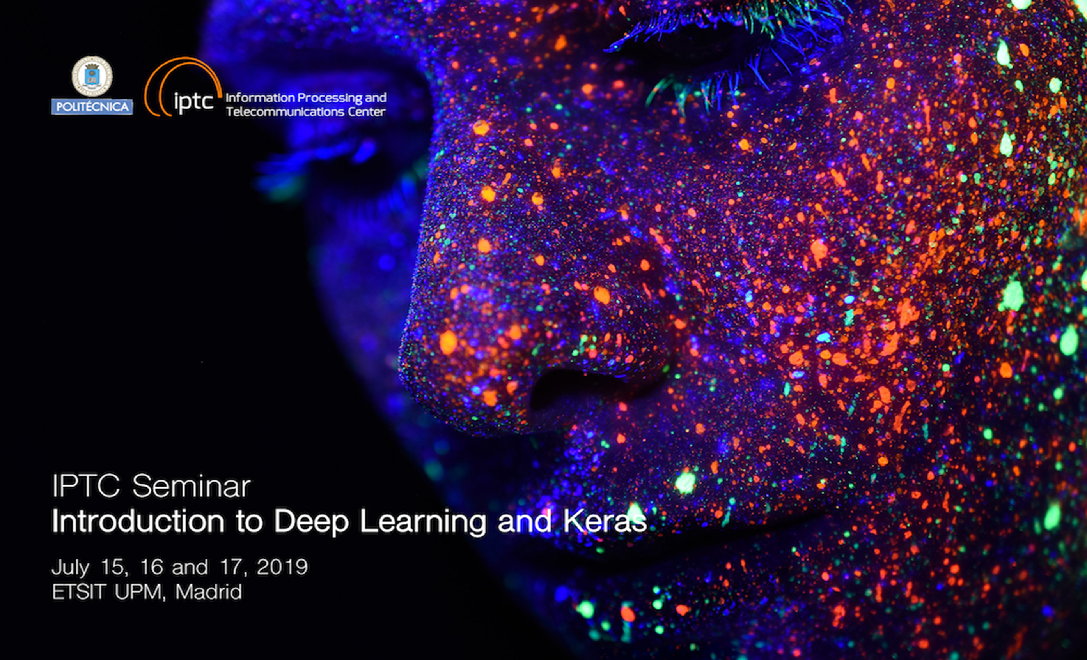

Slide 2
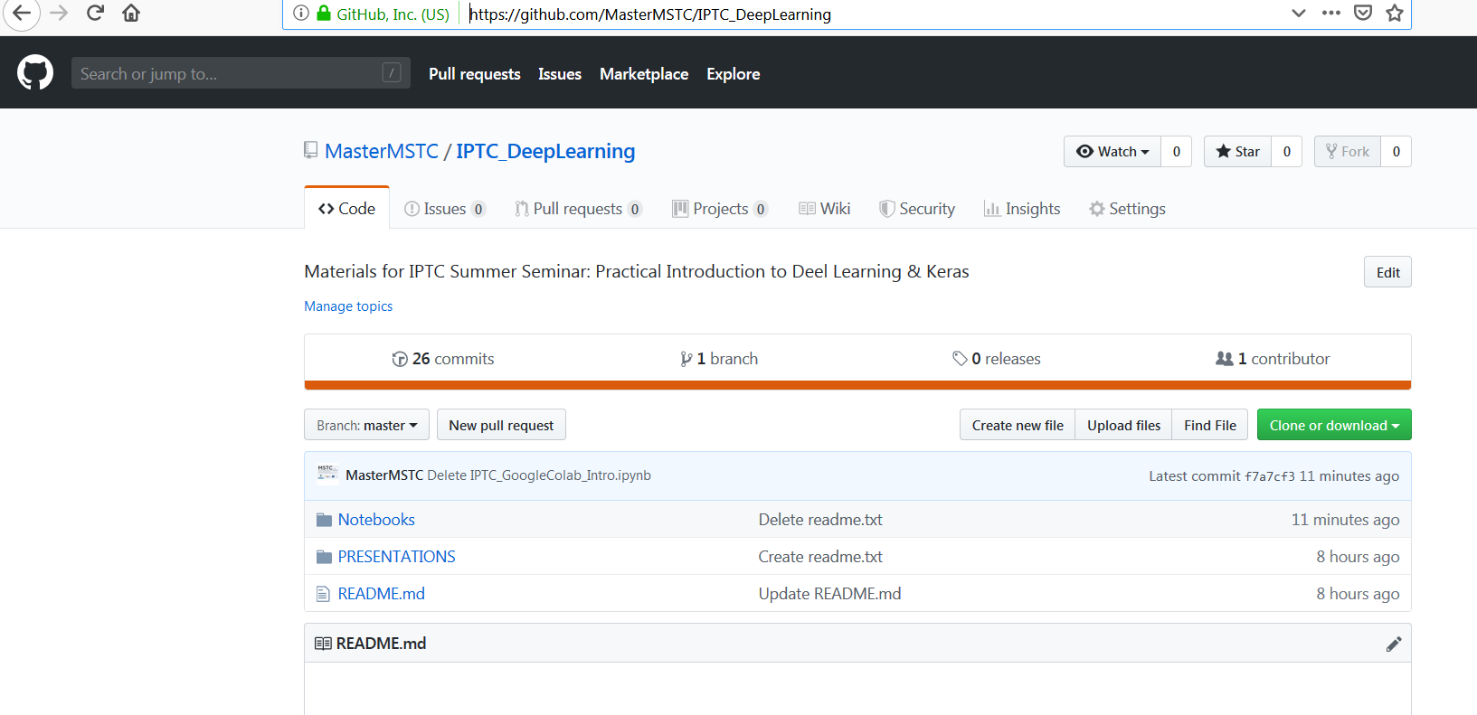
IPTC Summer Seminar MATERIALS
Please go to our MSTC GitHub:
https://github.com/MasterMSTC/IPTC_DeepLearning

Slide 3
Introduction to Deep Learning & Keras Day 2
Prof. Luis A. Hernández Gómez
luisalfonso.hernandez@upm.es

Slide 4
Day 1 (July 15) : Intro to Deep Learning & Keras.
Feed Forward models
Day 2 (July 16) : Backpropagation. Convolutional Networks
Transfer Learning. Data Augmentation.
Day 3 (July 17) : Recurrent Networks. Advanced Architectures.
GANs. Applications. Final discussion on AI

Slide 5
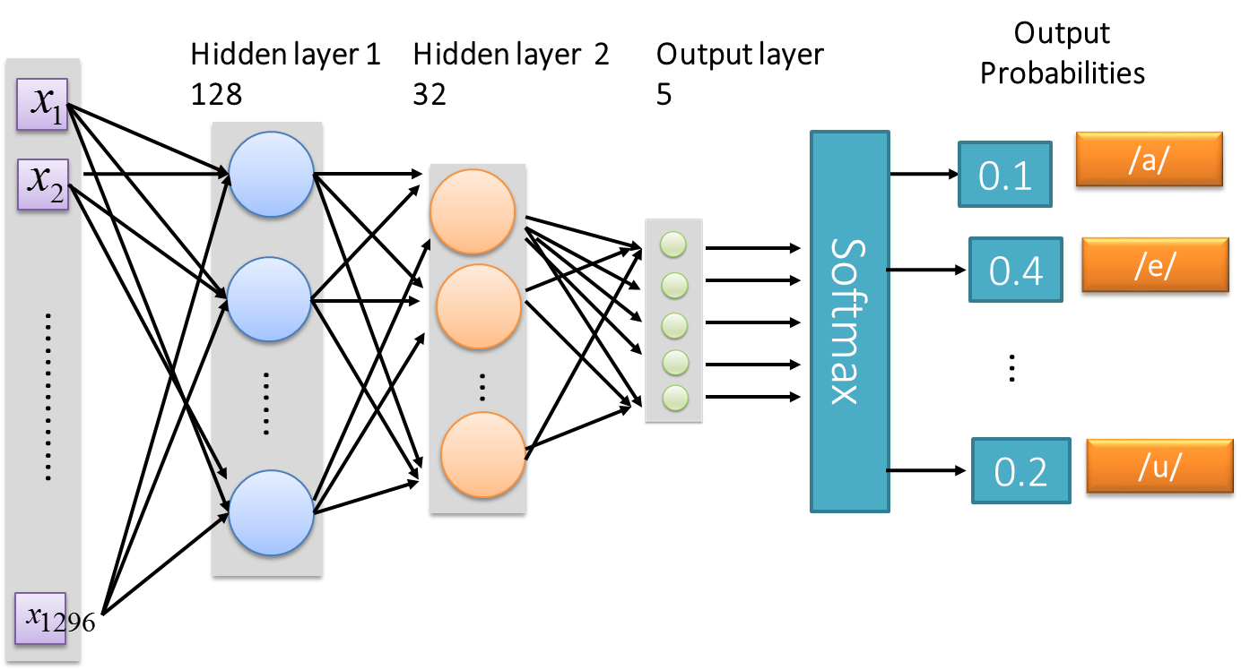
How are the Network Parameters estimated (best W and b values)?
W’s and b’s in every layer

Slide 6
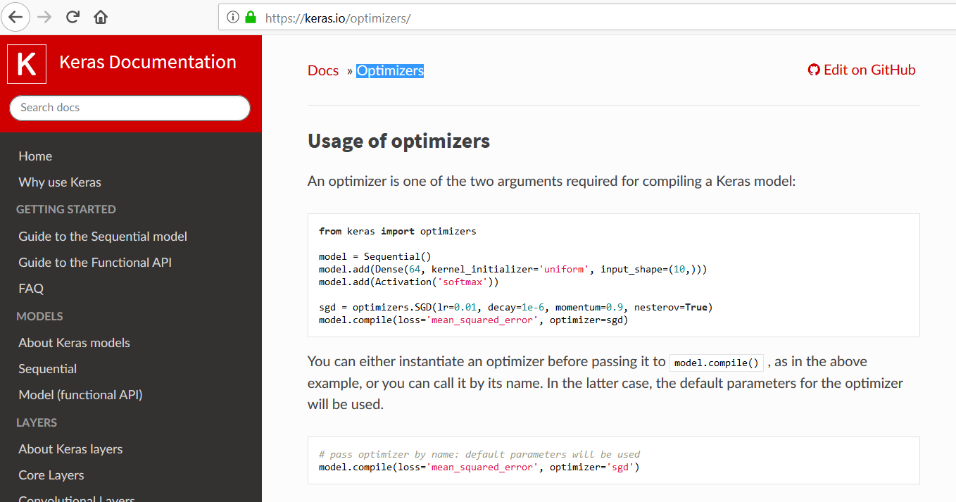
Optimizers
https://keras.io/optimizers/

Slide 7
Next Slides are from: Deep Learning Tutorial
李宏毅
Hung-yi Lee
Notes:
Not memtion
DT v.s. Deep!!!!!

Slide 8
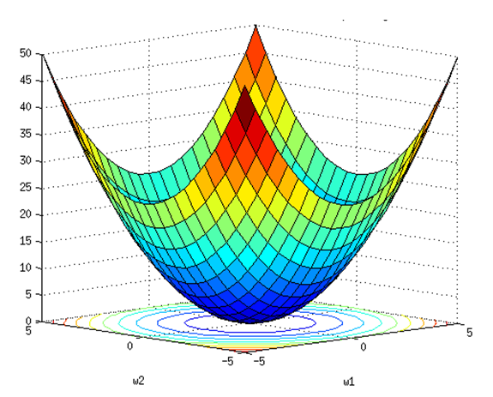
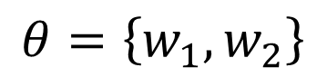
Gradient Descent
OPTIMIZATION
Cost
Or
Loss function
C(𝜃)
Assume there are only two parameters w₁ and w₂ in a network.
$$θ=\left\{w_{1},w_{2}\right\}$$

Slide 9
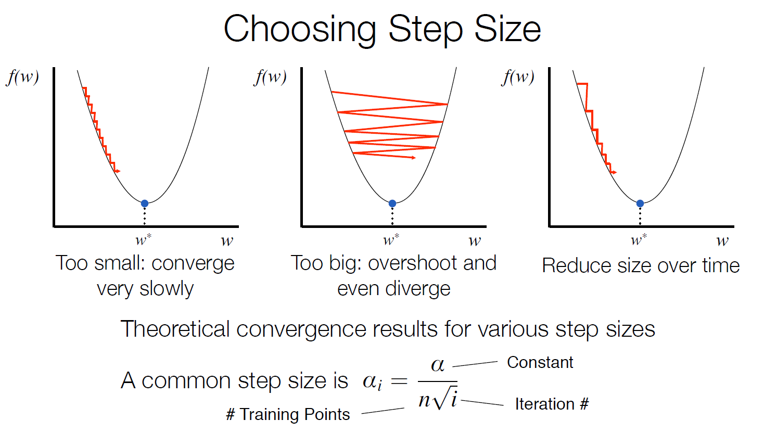

Source:

Slide 10
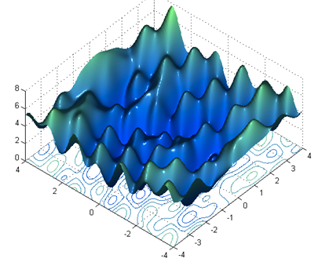
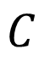
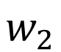
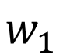
Gradient descent never guarantee global minima
Keep in mind that: Different initializations will
$$C$$
$$w_{2}$$
Reach different minima, so different results
$$w_{1}$$
Who is Afraid of Non-Convex Loss Functions? (17:36 -27:16 -30:41 min)
http://videolectures.net/eml07_lecun_wia/

Slide 11
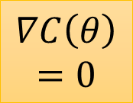
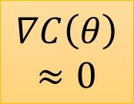

Besides local minima ……
cost
Very slow at the plateau
Stuck at saddle point
Stuck at local minima
$$∇C\left(θ\right)≈0$$
$$∇C\left(θ\right)=0$$
$$∇C\left(θ\right)=0$$
parameter space

Slide 12
In physical world ……
Momentum
How about put this phenomenon in gradient descent?
Notes:
Momentum: 動量

Slide 13
Momentum
Still not guarantee reaching global minima, but give some hope ……
cost
Movement =
Negative of Gradient + Momentum
Negative of Gradient
Momentum
Real Movement
Gradient = 0
Notes:
What can we see?

Slide 14
But What Cost function?
How to measure accuracy?
Cross-entropy
and
Maximum Likelihood Estimation

Slide 15
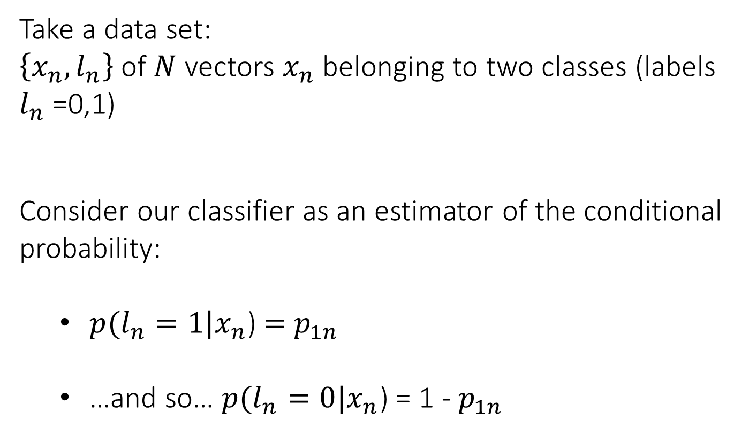
Intuitive approach for a two-class (binary) classifier
Take a data set:
$\left\{x_{n},l_{n}\right\}$ of $N$ vectors $x_{n}$ belonging to two classes (labels $l_{n}$ =0,1)
Consider our classifier as an estimator of the conditional probability:
$p(l_{n}=1|x_{n}$) = $p_{1n}$
…and so… $p(l_{n}=0|x_{n}$) = 1 - $p_{1n}$

Slide 16
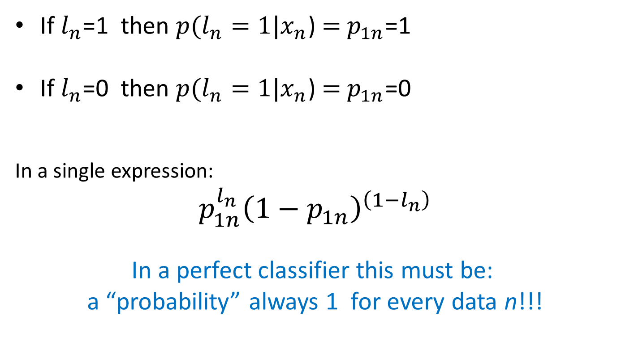
A PERFECT classifier
If $l_{n}$=1 then $p(l_{n}=1|x_{n}$) = $p_{1n}$=1
If $l_{n}$=0 then $p(l_{n}=1|x_{n}$) = $p_{1n}$=0
In a single expression:
$p_{1n}^{l_{n}}{\left(1−p_{1n}\right)}^{\left(1−l_{n}\right)}$
In a perfect classifier this must be:
a “probability” always 1 for every data n!!!

Slide 17
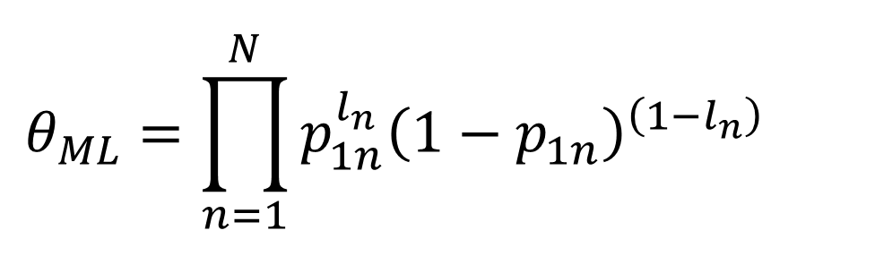
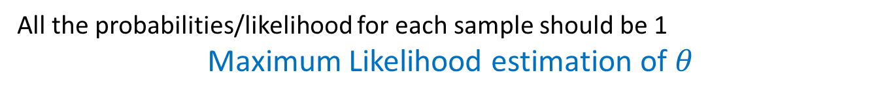
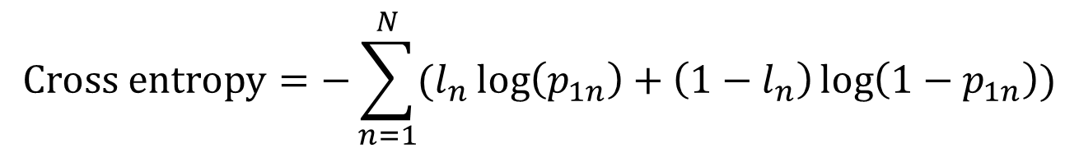
A PERFECT classifier
All the probabilities/likelihood for each sample should be 1
Maximum Likelihood estimation of $θ$
$${{θ_{ML}=\prod_{n=1}^{N}{p_{1n}^{l_{n}}{\left(1−p_{1n}\right)}^{\left(1−l_{n}\right)}}}_{}}_{}^{}$$
From that a Cost Function can be obtained taking: the negative logarithm = Cross-entropy
$$Cross entropy=−\sum_{n=1}^{N}{(l_{n}\log\left(p_{1n}\right)+\left(1−l_{n}\right)\log\left(1−p_{1n}\right))}$$
Understand the intuitive “power “of this Loss function

Slide 18
Training Neural Networks
Backpropagation
Refers to the method for Gradients estimation it is NOT an optimization method

Slide 19
Terminology
Example: Network function f: R³ → R²
output vector
y₁
y₂
output layer
hidden layer
input layer
x₁
x₂
x₃
input vector

Slide 20
output vector
y₁
y₂
x₁
x₂
x₃
input vector

Slide 21
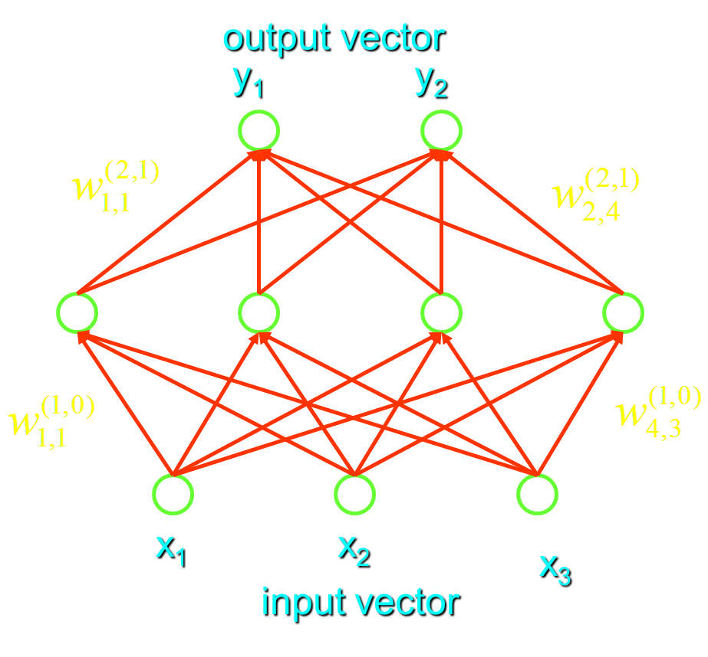
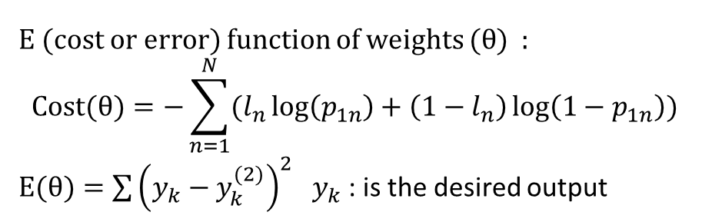
E (cost or error) function of weights $(θ$) :
$$Cost(θ)=−\sum_{n=1}^{N}{(l_{n}\log\left(p_{1n}\right)+\left(1−l_{n}\right)\log\left(1−p_{1n}\right))}$$
$E(θ)=\sum{{\left(y_{k}−y_{k}^{(2)}\right)}^{2}}$ $y_{k}$ : is the desired output
Backpropagation
For using gradient descent algorithms we need:
Output layer: easy
Hidden layer: difficult

Slide 22
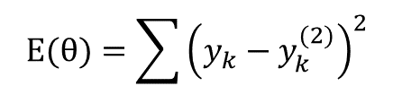
Backpropagation : apply the chain rule
$$E(θ)=\sum{{\left(y_{k}−y_{k}^{(2)}\right)}^{2}}$$

Slide 23

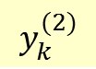
Hidden layer : NOTICE that each influences
each with k=1,… K (K=2 in our example)
$$E(θ)=\sum{{\left(y_{k}−y_{k}^{(2)}\right)}^{2}}$$
$$y_{k}^{(2)}$$
output vector
y₁
y₂
x₁
x₂
x₃

Slide 24

Hidden layer :
$$E(θ)=\sum{{\left(y_{k}−y_{k}^{(2)}\right)}^{2}}$$

Slide 25
Weight changes :
Output layer
Hidden layer

Slide 26
Using sigmoid derivative properties :
Output layer
Hidden layer

Slide 27
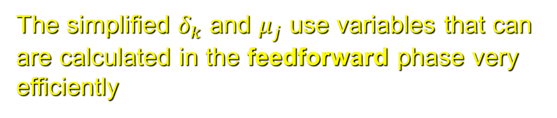
The simplified $δ_{k}$ and $μ_{j}$ use variables that can are calculated in the feedforward phase very efficiently
Output layer
Hidden layer

Slide 28
Algorithm first performs forward propagation, which maps parameters to loss or cost function associated training examples
Then the corresponding computation for applying the back-propagation algorithm is done

Slide 29
Backpropagation algorithm computes the gradient, while another algorithm, such as stochastic gradient descent, is used to perform learning using this gradient

Slide 30
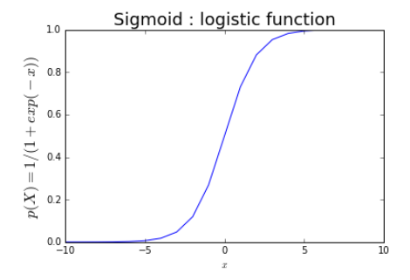
Sigmoidal Neurons

Slide 31
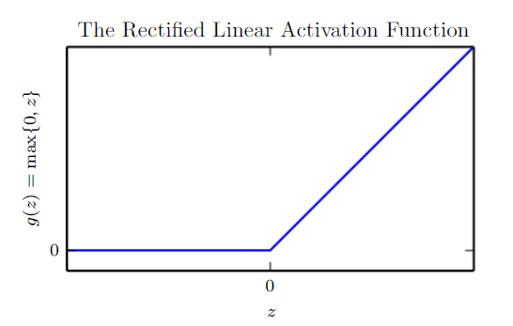
Activation Functions
In modern neural networks, the default recommendation is to use the rectified linear unit or ReLU
…
weights
Discuss why?

Slide 32
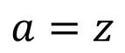
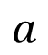
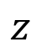
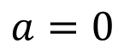
ReLU
$$a$$
$$a=z$$
$$a=0$$
$$z$$
0
0
0
0

Slide 33
ReLU
$$a$$
$$a=z$$
A Thinner linear network
$$a=0$$
$$z$$
Do not have smaller gradients

Slide 34












Maxout
ReLU is a special cases of Maxout
Learnable activation function [Ian J. Goodfellow, ICML’13]
+
neuron
+
$$5$$
$$1$$
Input
Max
$$7$$
Max
$$2$$
+
$$7$$
+
$$2$$
+
$$−1$$
+
$$4$$
Max
$$1$$
Max
$$4$$
+
$$1$$
+
$$3$$
You can have more than 2 elements in a group.
Notes:
How to train? Latter
2013
Ian J. Goodfellow goodfeli@iro.umontreal.ca David Warde-Farley wardefar@iro.umontreal.ca Mehdi Mirza mirzamom@iro.umontreal.ca Aaron Courville aaron.courville@umontreal.ca Yoshua Bengio

Slide 35
Adaptive learning rate ……
Adagrad [John Duchi, JMLR’11]
RMSprop
https://www.youtube.com/watch?v=O3sxAc4hxZU
Adadelta [Matthew D. Zeiler, arXiv’12]
Adam [Diederik P. Kingma, ICLR’15]
AdaSecant [Caglar Gulcehre, arXiv’14]
“No more pesky learning rates” [Tom Schaul, arXiv’12]
Notes:
Ada delta: http://www.matthewzeiler.com/pubs/googleTR2012/googleTR2012.pdf
Adam: http://arxiv.org/pdf/1412.6980.pdf
AdaSecant
http://arxiv.org/pdf/1412.7419v4.pdf
“No more pesky learning rates”
http://arxiv.org/pdf/1206.1106.pdf
Adasecodn: Yoshua Bengio
No learning rate: Yann LeCun
SECANT: sec (not mentioned)
http://arxiv.org/pdf/1412.7419v4.pdf

Slide 36
Tips for Training DNN fighting against overfitting
Dropout

Slide 37
Dropout
Training:
Each time before computing the gradients
Each neuron has p% to dropout
Notes:
Iteration v.s. epoch!!!!!!!!

Slide 38
Dropout
Training:
Thinner!
Each time before computing the gradients
Each neuron has p% to dropout
The structure of the network is changed.
Using the new network for training
For each mini-batch, we resample the dropout neurons
Notes:
Do not worry that someone will not update

Slide 39
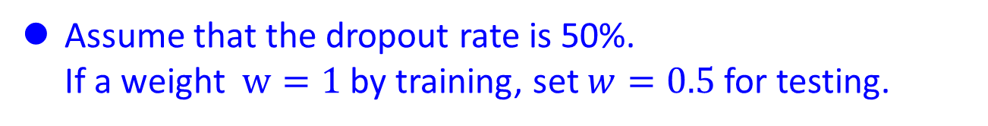
Dropout
Testing:
No dropout
If the dropout rate at training is p%, all the weights times (1-p)%
Assume that the dropout rate is 50%.
If a weight $w=1$ by training, set $w=0.5$ for testing.

Slide 40
Dropout is a kind of ensemble.
minibatch
1
minibatch
2
minibatch
3
minibatch
4
Training of Dropout
M neurons
……
2^{M} possible networks
Using one mini-batch to train one network
Some parameters in the network are shared

Slide 41
Dropout is a kind of ensemble.
Testing of Dropout
testing data x
All the weights multiply (1-p)%
……
y₁
y₂
y₃
average
≈
y
Notes:
0,0 -> 0
1,0 -> 1
0,-1 -> -2
1,-1 -> -1
½, -1/2 -> -0.5
1,2
Geometric Mean?

Slide 42
More about dropout
More reference for dropout [Nitish Srivastava, JMLR’14] [Pierre Baldi, NIPS’13][Geoffrey E. Hinton, arXiv’12]
Dropout works better with Maxout [Ian J. Goodfellow, ICML’13]
Dropconnect [Li Wan, ICML’13]
Dropout delete neurons
Dropconnect deletes the connection between neurons
Annealed dropout [S.J. Rennie, SLT’14]
Dropout rate decreases by epochs
Standout [J. Ba, NISP’13]
Each neural has different dropout rate

Slide 43
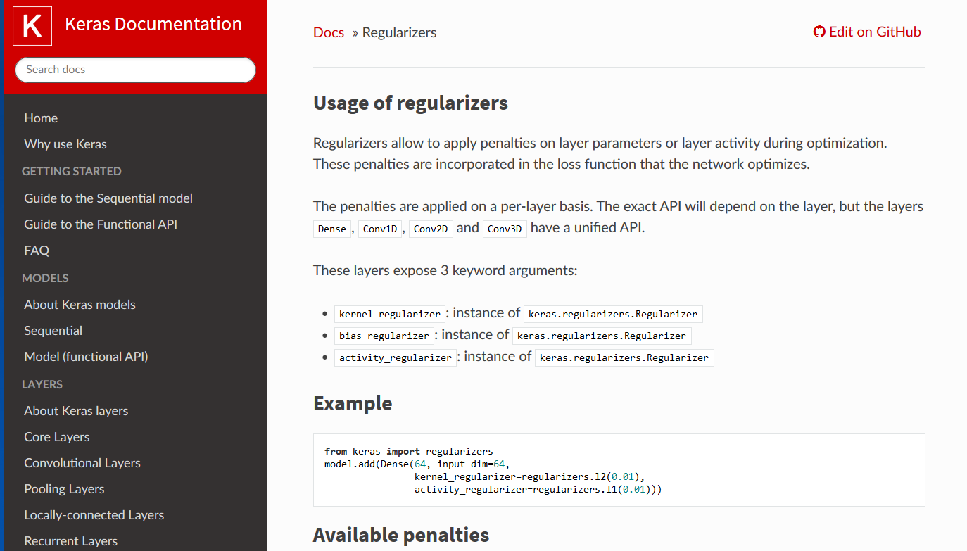
Regularizers: fighting against overfitting

Slide 44
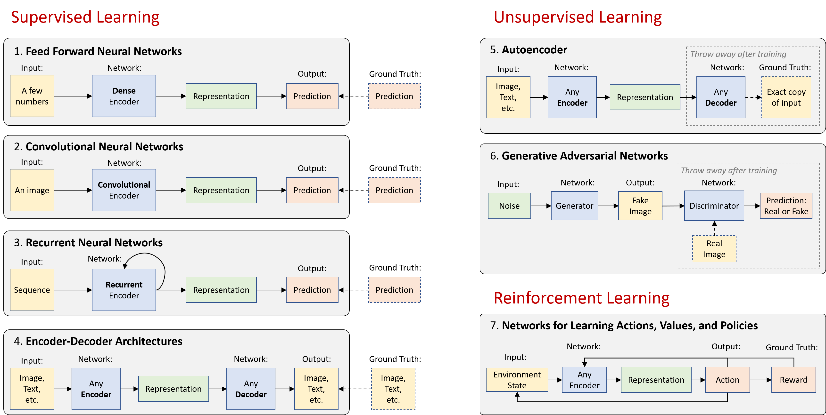
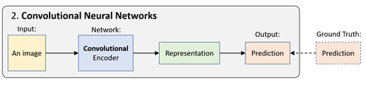
Deep learning basics
https://github.com/lexfridman/mit-deep-learning/blob/master/tutorial_deep_learning_basics/deep_learning_basics.ipynb

Slide 45
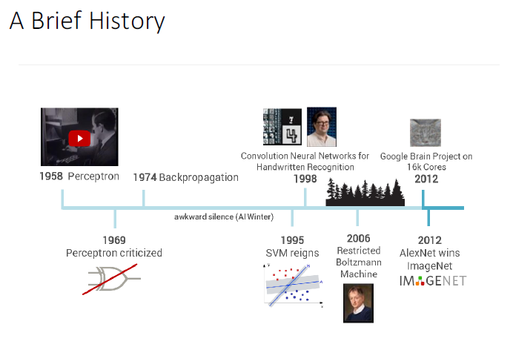
CNN / ConvNets: Convolutional Neural Network
organizes neurons based on animal’s visual cortex system, which allows for learning patterns at both local level and global level.
Y. LeCun, L. Bottou, Y. Bengio and P. Haffner: Gradient-Based Learning Applied to Document Recognition, Proceedings of the IEEE, 86(11):2278-2324, November 1998

Slide 46
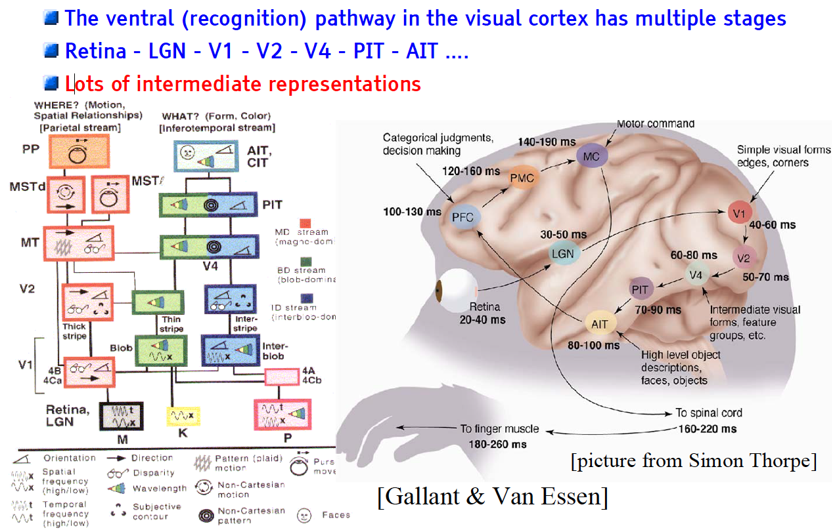
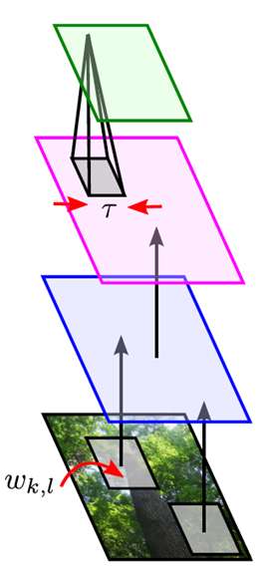
The Mammalian Visual Cortex Inspires CNN
Convolutional Neural Net
output
input

Slide 47
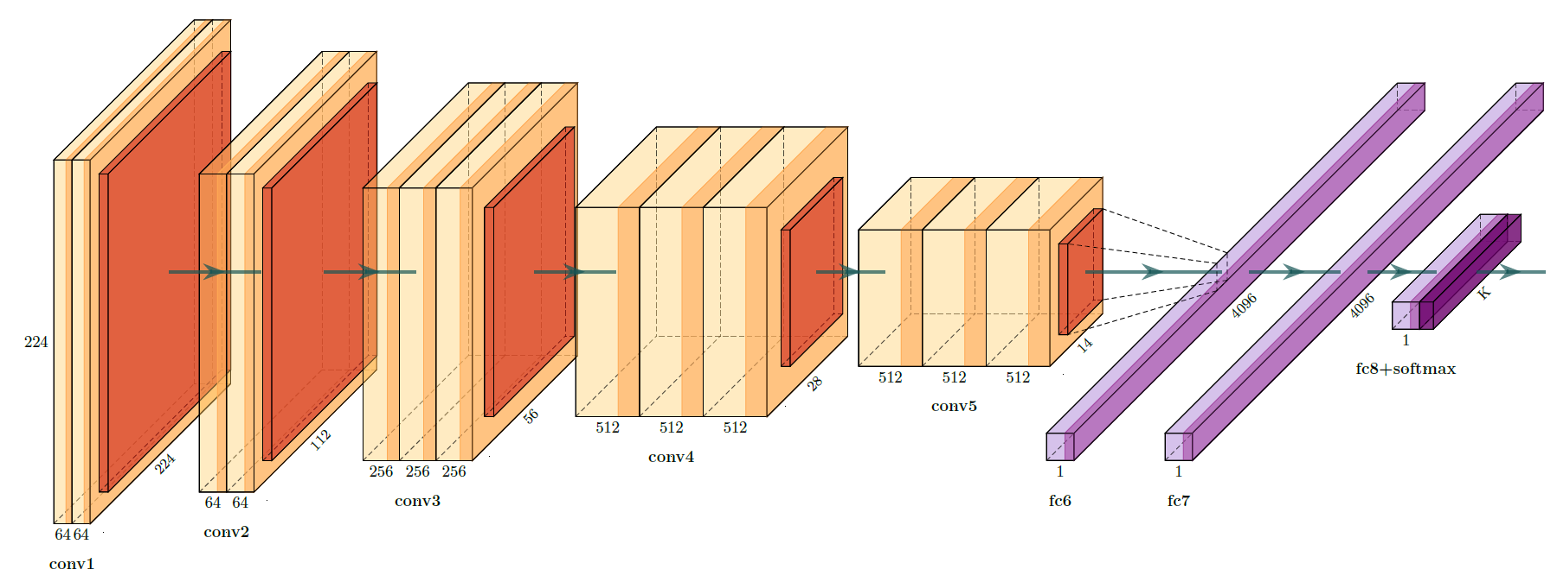
CNN as : Feature extraction + Classification (or Regression)
Feature extraction
Classification
(or Regression)

Slide 48
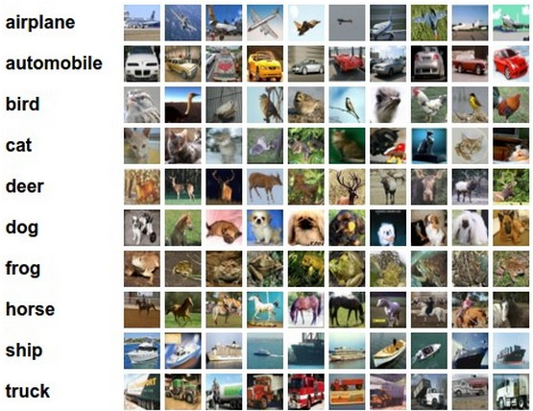
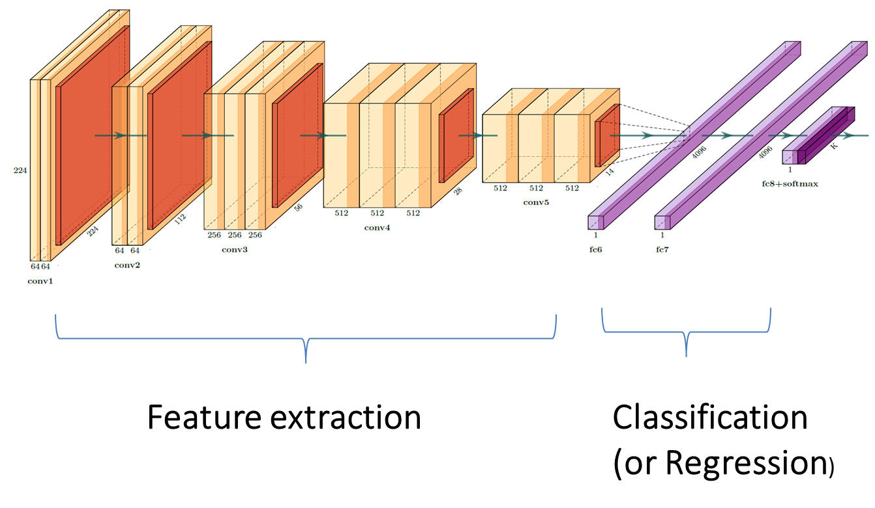
CNN as : Feature extraction + Classification (or Regression)
… but what about the
Input?
… images?
… time series, signals,…?

Slide 49
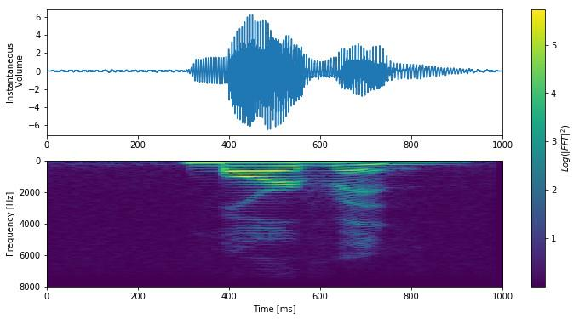

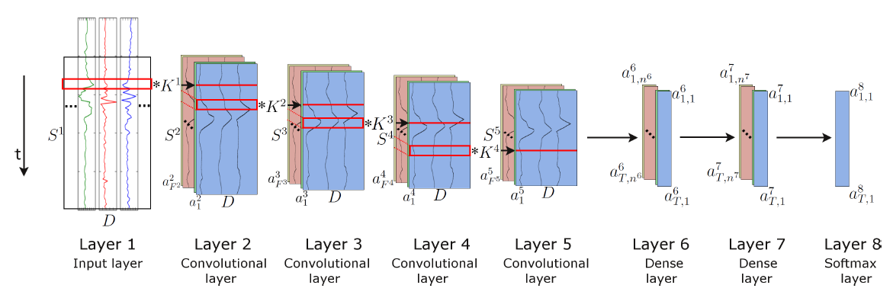
1D, 2D, 3D CNN
… time series, signals,…?
2D Conv: for example working with spectrogram-like inputs
But also 1D Conv when working with raw time series or signals

Slide 51


Slide 57
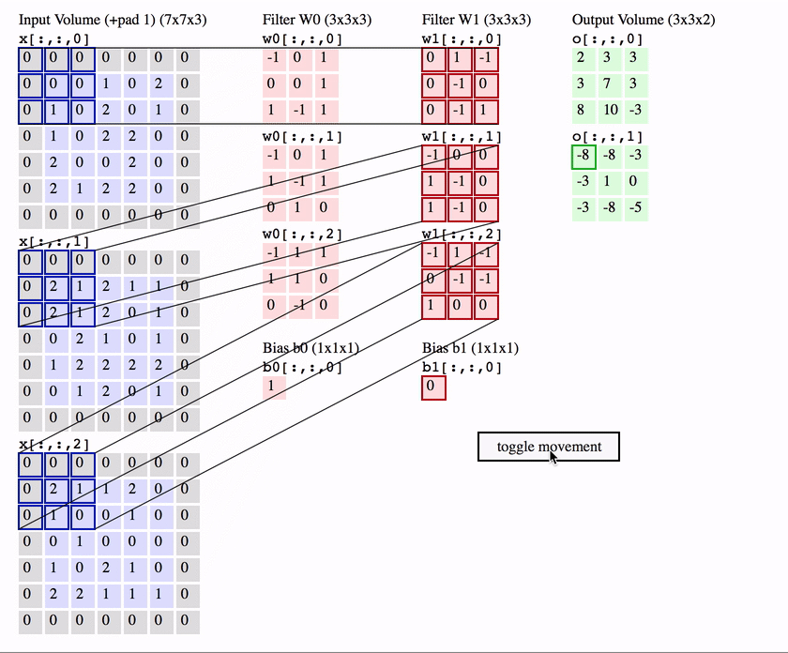
CNN nice visualization
http://cs231n.github.io/convolutional-networks/

Slide 58
Stride and Padding

Slide 59
Stride and Padding

Slide 60
Stride and Padding

Slide 61
Stride and Padding

Slide 62
Stride and Padding
Stride = 1
Padding = 0

Slide 63
Stride and Padding
Stride = 2
Padding = 0

Slide 64
Stride and Padding

Slide 65
Stride and Padding

Slide 66
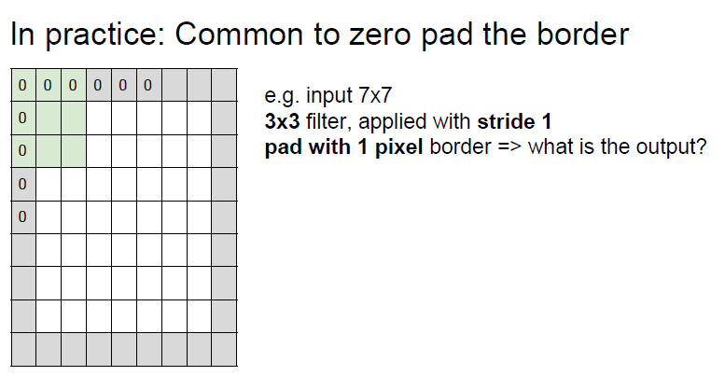
Stride and Padding

Slide 67
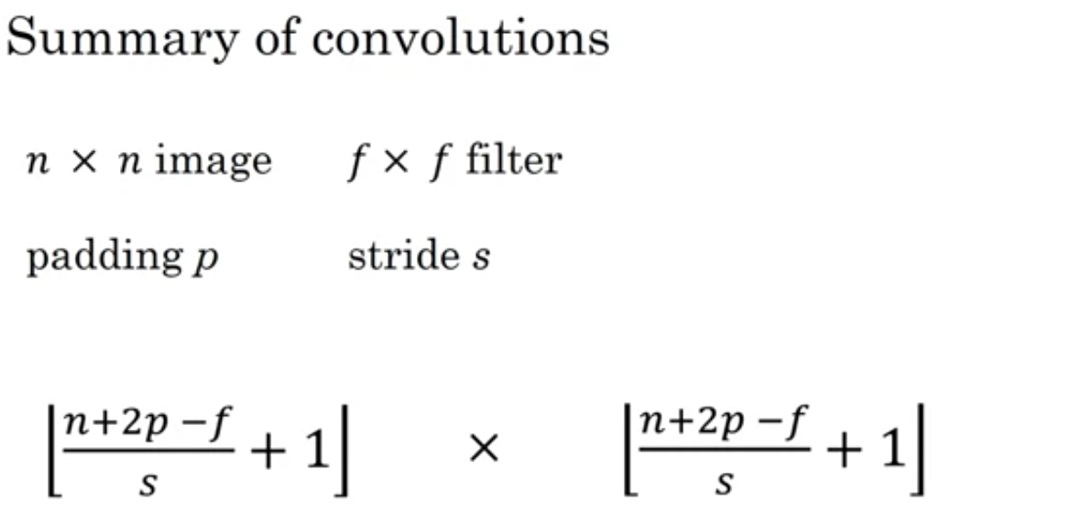
From: Andrew Ng

Slide 71
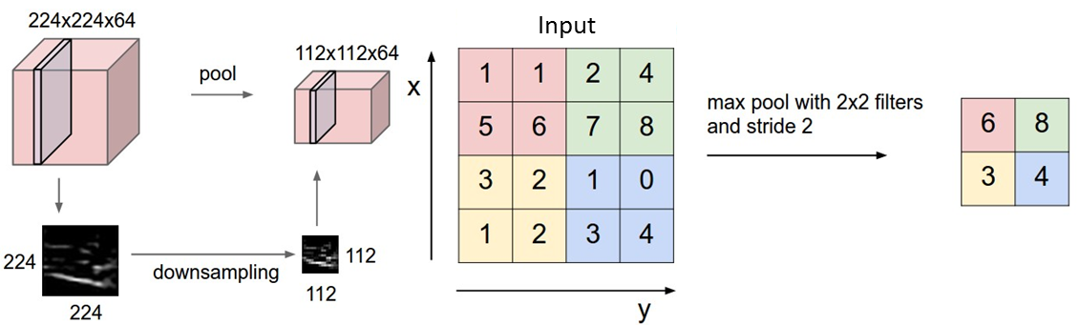
CNN Architecture: Pooling Layer
Makes the representation smaller and more manageable
Operates over each activation map independently

Slide 72

CNN / ConvNet Architecture:
https://sefiks.com/2017/11/03/a-gentle-introduction-to-convolutional-neural-networks/

Slide 73

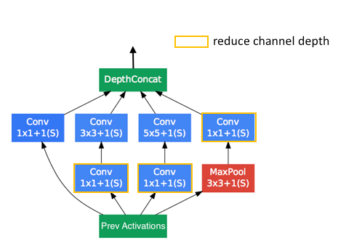
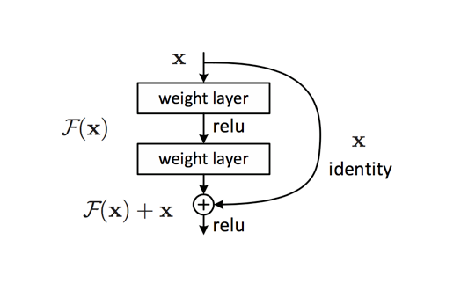
…there are many Convolutional Network Architectures
Common architectures in convolutional neural networks
https://www.jeremyjordan.me/convnet-architectures/
VGG (16)
ResNet (50) Inception-v3 (GoogLeNet)

Slide 74

Font Recognition using CNN with Keras:
IPTC_Keras_FontReco_CNN.ipynb

Slide 75
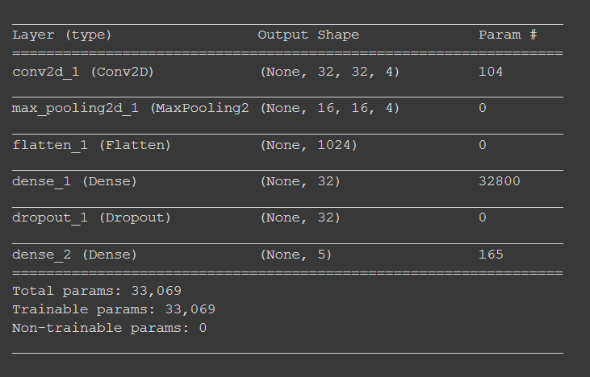
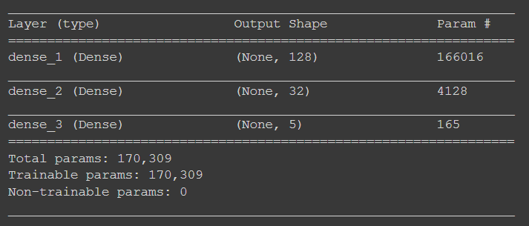
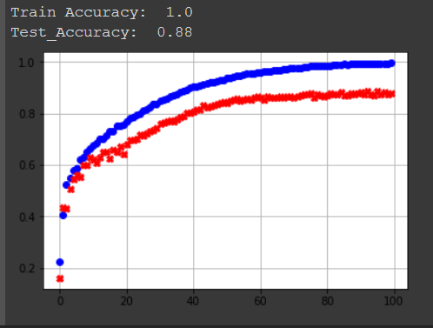

Font Recognition

Slide 76

Building-powerful-image-classification-models-using-very-little-data Transfer Learning, Data Augmentation, ….
https://blog.keras.io/building-powerful-image-classification-models-using-very-little-data.html

Slide 77


Slide 78
Transfer Learning
You can have a quick overview
Transfer learning and Image classification using Keras on Kaggle kernels.
https://towardsdatascience.com/transfer-learning-and-image-classification-using-keras-on-kaggle-kernels-c76d3b030649
Transfer learning is a popular training technique used in deep learning; where models that have been trained for a task are reused as base/starting point for another model.
It has been mainly used in image classification but can be used/extended to many other fields such audio

Slide 79
Transfer Learning: pre-trained models
Keras comes prepackaged with many types of these pretrained models. Some of them are:
VGGNET : Introduced by Simonyan and Zisserman in their 2014 paper, Very Deep Convolutional Networks for Large Scale Image Recognition.
RESNET : First introduced by He et al. in their 2015 paper, Deep Residual Learning for Image Recognition
INCEPTION: The “Inception” micro-architecture was first introduced by Szegedy et al. in their 2014 paper, Going Deeper with Convolutions:
XCEPTION: Xception was proposed by François Chollet , the creator of the Keras library.
and many more. Detailed explanation of some of these architectures can be found here.
https://towardsdatascience.com/transfer-learning-and-image-classification-using-keras-on-kaggle-kernels-c76d3b030649

Slide 80
Transfer Learning : Font-type recognition
IPTC_Keras_FontReco_TransferLearning.ipynb
See an example of using Transfer Learning (VGG 16) for Font-type recognition

Slide 81


Slide 82



Slide 83


Slide 84

Learn the use of Keras API

Slide 85
Keras: Functional API see: https://keras.io/getting-started/functional-api-guide/
Getting started with the Keras functional API
The Keras functional API is the way to go for defining complex models, such as multi-output models, directed acyclic graphs, or models with shared layers.
With the functional API, it is easy to reuse trained models: you can treat any model as if it were a layer, by calling it on a tensor

Slide 86
from keras.layers import Input, Dense
from keras.models import Model
# This returns a tensor
inputs = Input(shape=(784,))
# a layer instance is callable on a tensor, and returns a tensor
x = Dense(64, activation='relu')(inputs)
predictions = Dense(10, activation='softmax')(x)
A layer instance is callable (on a tensor), and it returns a tensor
Input tensor(s) and output tensor(s) can then be used to define a Model
model = Model(inputs=inputs, outputs=predictions)
Such a model can be trained just like Keras Sequential models.

Slide 87


Slide 88

All models are callable, just like layers
With the functional API:
it is easy to reuse trained models: you can treat any model as if it were a layer, by calling it on a tensor. (Transfer Learning)
Note that by calling a model you aren't just reusing the architecture of the model, you are also reusing its weights

Slide 89

https://towardsdatascience.com/a-comprehensive-hands-on-guide-to-transfer-learning-with-real-world-applications-in-deep-learning-212bf3b2f27a

Slide 90

A final example: Convolutional Networks for Time Series
See how CNN can be used for time series, in this case: Human-Activity-Recognition (HAR)
IPTC_Keras_HAR_CNN.ipynb

Slide 91
Deep learning basics
https://github.com/lexfridman/mit-deep-learning/blob/master/tutorial_deep_learning_basics/deep_learning_basics.ipynb

